Slide 1
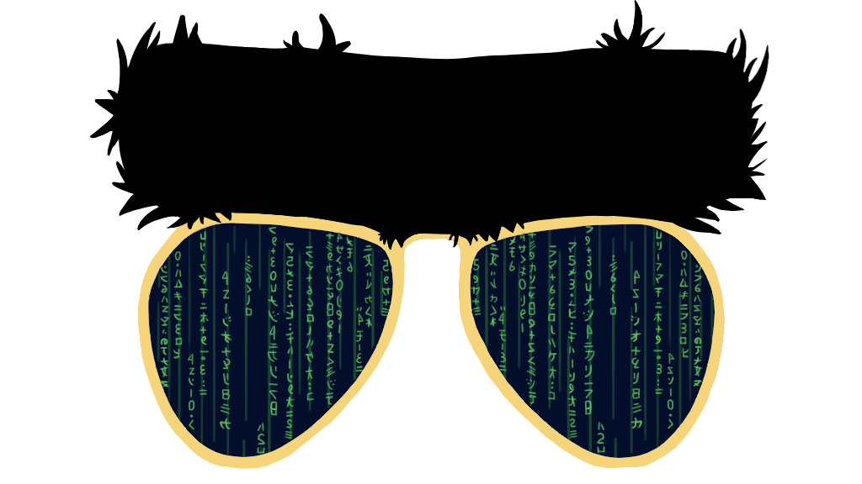
W210
Capstone Presentation
BERTVision
Improving performance on a wide range of Natural Language Processing tasks using parameter-efficient model architectures training on BERT’s hidden state activations
Andrew Fogarty and Cristopher Benge and Siduo Stone Jiang and William Casey King

Slide 2
INTRODUCTION
read the paper | project website
Efficiency
High parameter-efficiency (compared to BERT) for a wide-range of NLP tasks, reducing time and computation generally required for fine-tuning.
Accessibility
BERT and other large, high-performance transformer models are expensive – and you’re not made of money!
Performance
All other compression techniques on offer trade efficiency for performance; our approach [typically] does not.
Overlooked / Underutilized Inner Structures
BERT and other transformer model architectures learn and then throw away useful hidden-state activations; our approach collects and distills that wealth of free information.
Motivation

Slide 3
Related Work
We did broad background research and have cited over 30 papers, but these four stand out as significant to the domain, our research, and our approach.
BERT Rediscovers the Classical NLP Pipeline
SqueezeBERT: What can computer vision teach NLP about efficient neural networks?
Tenney et al., 2019
BERT: Pre-training of Deep Bidirectional Transformers for Language Understanding
Parameter-Efficient Transfer Learning for NLP
Iandola et al., 2020
Houlsby et al., 2019
Devlin et al., 2018

Slide 4
Problem Definition
BERT, the canonical transformer, significantly advanced the state of NLP at substantive cost
Minimizing fine-tuning costs while maximizing performance presents a non-trivial challenge
Academic field engineered compression techniques spanning: (1) distillation, (2) quantization, and (3) pruning, and (4) module replacing
The state-of-the-art exposes gaps in research at the fine-tuning vice pre-training stage
We propose BERT-Vision, a compression method that captures regularities during fine-tuning

Slide 5
BERT_{LARGE}
TRAIN Embeddings (131911, 386, 1024, 25)
Transformer Block₂₄
Learned Pooling Weights (26,)
Embeddings Generated (N, 386, 1024, 25)
Pooled Embeddings (N,386,1024)
Transformer Block₃
Transformer Block₂
Dense(2,386)
Transformer Block₁
$$h_{i,τ}=γ\sum_{ι=0}^{Ι}{w_{τ}^{(ι)}h_{i}^{(ι)}}$$
Input embedding : | (N, 386, 1024, 1)
Layer 1-24 output[0] token : | (N, 386, 1024, 24)
Span Start
input embeddings
DEV Embeddings (12227, 386, 1024, 25)
Span End
Inspired by Tenney et al. 2019

Slide 6
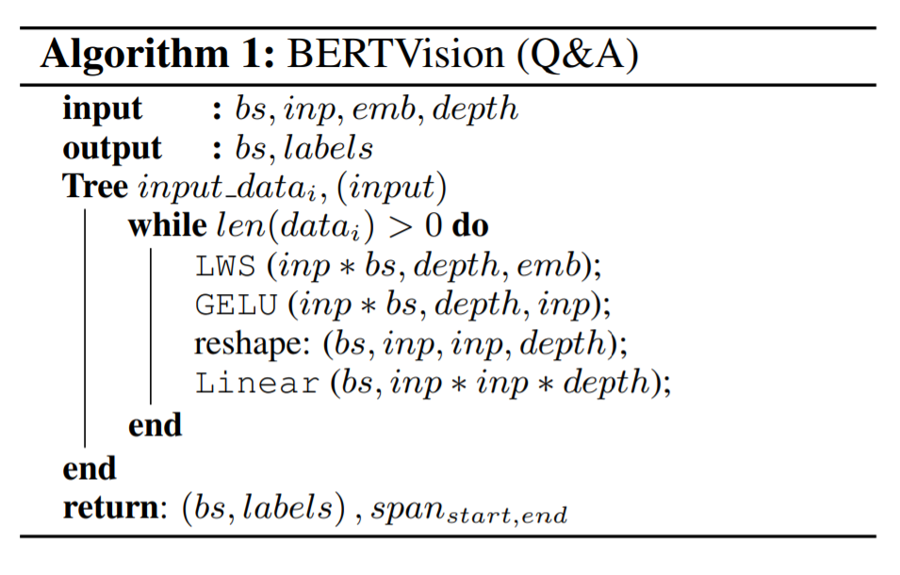
Our Solution
Span Start
Span End
Span Start
Span End
CLS
Transformer Block₂₄
(386, 2)
+
(386, 9650)
Transformer Block₃
(386, 386, 25)
Transformer Block₂
Adapter
Transformer Block₁
Model Input (386, 1024, 25)
input embeddings
BERT
BERTVision

Slide 7
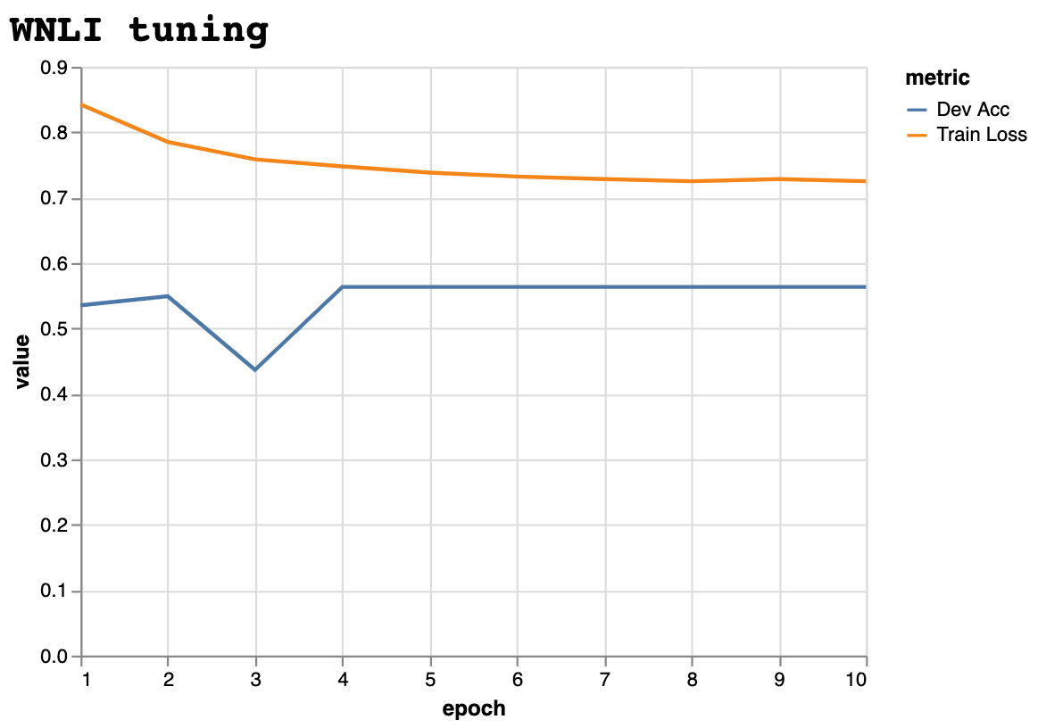
WNLI – Winograd natural language inference
Data and EDA
From the GLUE website:
The test set has a different label distribution than the train and dev sets.
From the original BERT paper:
There are issues with the construction of this dataset, and every trained system that’s been submitted to GLUE has performed worse than the 65.1 baseline accuracy of predicting the majority class. We therefore exclude this set to be fair to OpenAI GPT. For our GLUE submission, we always predicted the majority class.
arXiv:1810.04805
Decision: Skip this dataset
Benchmark NLP Tasks

Slide 8
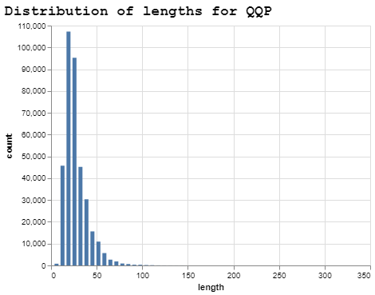
Embedding size
Data and EDA
Choice of embedding size greatly impacts efficiency of BERTVision
Handling larger sizes
Custom code that splits the paragraph into multiple segments, each with an overlap (“doc stride”), up to the maximum length. At inference time, a label for each segment is predicted, and the with the largest probability is used for the final predicted outcome of that example.
Decision: 99th percentile of sizes in the training set
Benchmark NLP Tasks

Slide 9
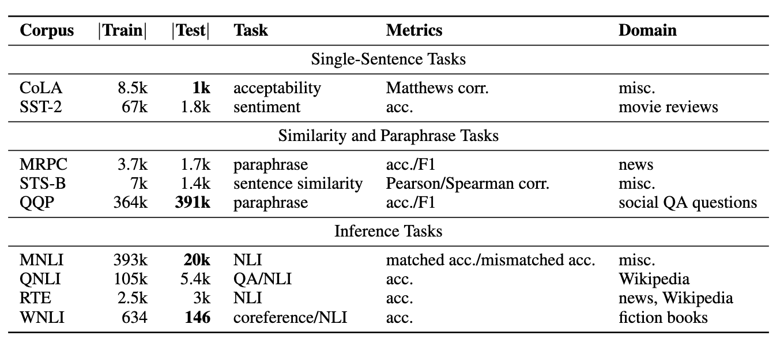
Data and Metrics
Performance and Dataset
Efficiency
Fraction of BERT’s parameters
Estimate for FLOPS (speedup)
Training
Inference
SQuAD v2
131K
18k
QA/NLI
acc./F1
Many
Comparisons made to BERT and other compression models
Evaluating Performance
Table Citation:
Wang, Alex, et al. “GLUE: A Multi-Task Benchmark and Analysis Platform for Natural Language Understanding.” ACL Anthology, www.aclweb.org/anthology/W18-5446/.

Slide 10
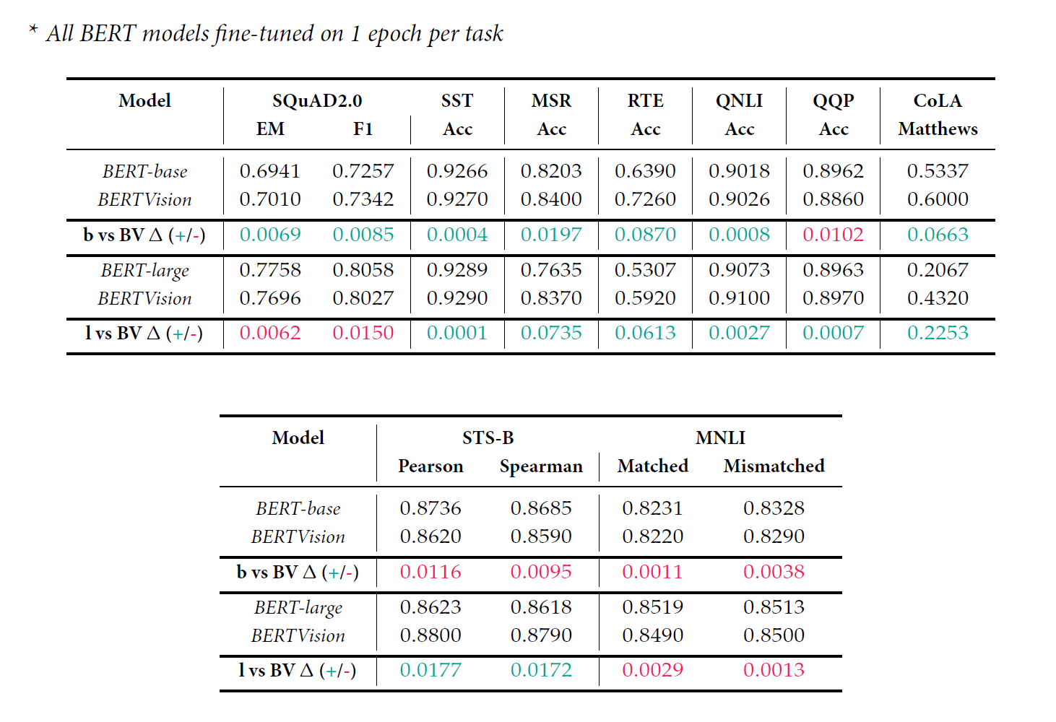
Our Results
Results per task

Slide 11
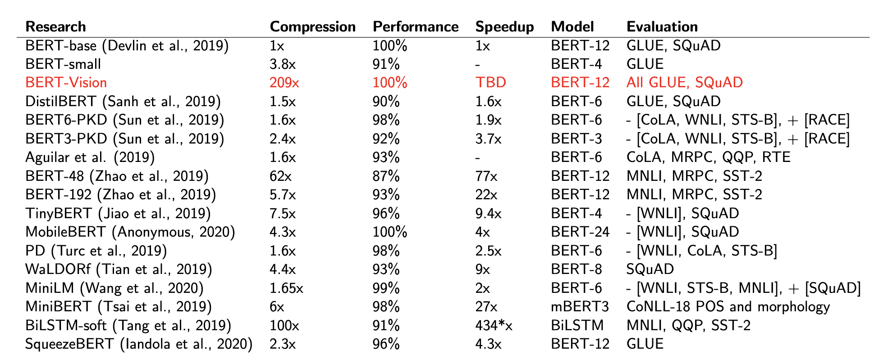

Our Results
Overall results compared to other work

Slide 12
Conclusion
Summary thoughts on our research
In recent years, transformer-based language models have yielded substantial progress in many natural language processing tasks.
Self-supervised pre-training via variants of language modeling losses means models trained on broad corpora can improve downstream performance on a wide range of tasks.
However, high parameter counts, and a large computational footprint mean production deployment of BERT and friends remains difficult.
The past 2 years have seen the development of a diverse variety of techniques to ease the pain and yield faster prediction times.
A comparison of the suite of smaller parameter models established BERTVision as producing state of the art results with orders of magnitude smaller number of parameters.
We are the current leaders when combining considerations of parameter-size and performance.

Slide 13
Future Work
Proposed ideas on continued research
BERTVision currently requires use of storage space for embeddings taken from fine-tuned BERT as a pre-step to training the AdapterPooler model. To improve efficiency in approach, refactoring to incorporate the AdapterPooler in-line between transformer layers within BERT (much as AdpaterBERT does) would eliminate the requirement for storage and the additional steps required to generate the embeddings.
BERTVision currently uses all hidden activation layers for all NLP tasks, but from Tenney et al. we know that some layers are more or less important depending on the specific NLP task of interest. A proposed area of research would be to intelligently select the embeddings on a per-task basis, further improving efficiency and possibly performance.
The BERT [minimal] fine-tuning step is the largest pain-point for BERTVision. Over-parameterization within large transformer models is a key reason for this pain; exploration of randomly freezing percentages of weights or specific layers on a per-task basis and evaluating where performance starts to drop is a fertile area of research that would further improve the efficiency of the BERTVision approach.

Slide 14
W210
Capstone Presentation
THANKS
Fiat Lux

